Slide 1


TITLE OF THE MINI-PROJECT
AUTONOMOUS CAR PARKING SYSTEM
Sreyas Institute of Engineering and Technology
An Autonomous Institution
Approved by AICTE, Affiliated to JNTUH
Accredited by NAAC-A Grade, NBA (CSE, ECE & ME) & ISO 9001:2015 Certified
Department of Electronics & Communication Engineering
Under the Guidance of
Mrs.N.Chandana
Presented by [A-7]
C.Varsha (22VE1A0410)
M.Hemanth (22VE1A0434)
J.Ganesh(22VE1A0421)
Title of the Project

Slide 2
Abstract
The project is an Autonomous Car Parking System designed to park vehicles without human intervention.
ESP32 microcontroller is used as the core controller for processing and decision-making.
L298N motor driver controls the L gear motors for movement and steering of the vehicle.
A battery pack supplies power, regulated by a buck controller for stable voltage levels.
The system includes a charging module and adapter for safe and efficient battery recharging.
Jumper wires are used to interconnect components, making the system modular and easy to maintain.
The ESP32 enables wireless control and remote monitoring through its built-in Wi-Fi and Bluetooth.
Title of the Project

Slide 3

Components
ESP32
Driver(L298N)
Gear Motors(L)
Battery Pack
Charging module + Adaptor
App
Buck Control
Jumper Wires
Title of the Project

Slide 4
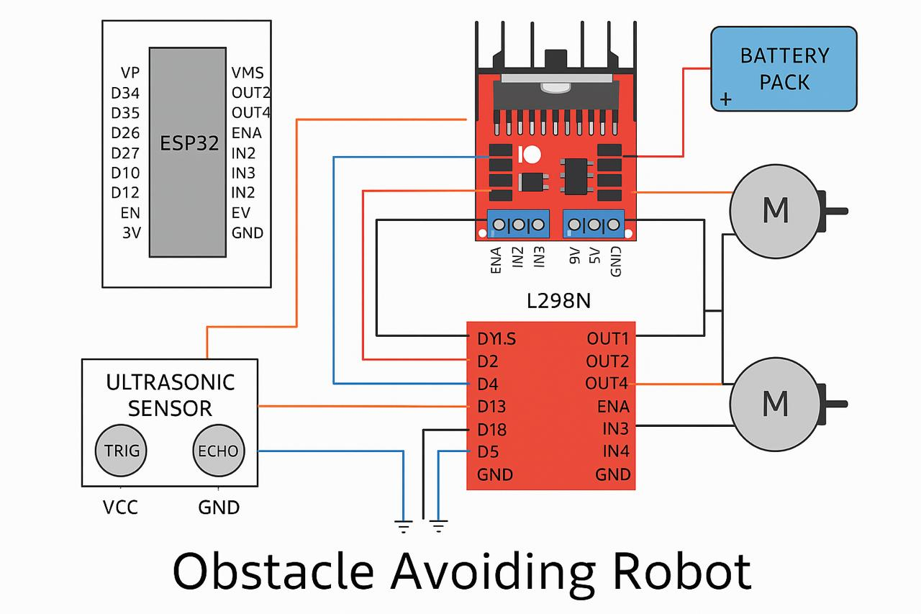
Functional Diagram
Autonomous car parking system.
Title of the Project

Slide 5
Specifications
ESP32
Wi-Fi Frequency Band: 2.4 GHz (supports IEEE 802.11 b/g/n)
L298N Motor Driver
Operating Voltage: 5V–35V for motor supply (Vs), and 5V logic supply (Vss)
L-Type Gear Motor
Rated Voltage: 6V DC (common value; varies by model)
Buck Converter (Buck Controller)
Output Voltage Range: Adjustable, typically 1.25V to 30V, depending on the model (e.g., LM2596)
Jumper Wires
Current Rating: Typically up to 1 Amp
Title of the Project

Slide 6
Working
Ultrasonic Sensors (HC-SR04):
There are four ultrasonic sensors on the front of the robot.
These sensors continuously send and receive ultrasonic signals to detect obstacles.
They measure the distance to objects in front, left, and right of the robot.
Microcontroller (ESP32):
Collects distance data from the ultrasonic sensors.
Processes the data to determine if there is an obstacle.
Based on logic (e.g., if obstacle ahead, turn left/right), it decides the motor actions.
Motor Driver Module (L298N):
Receives direction and speed control signals from the microcontroller.
Drives the L-type gear motors accordingly.
Power Supply (Battery Pack with Buck Converter):
Supplies regulated power to the microcontroller and motors.
The buck converter ensures voltage is stepped down appropriately for ESP32 and sensors.
Chassis & Motors:
Four-wheel drive with geared motors for stability and strength.
Allows forward/backward movement and turning.
Title of the Project

Slide 7
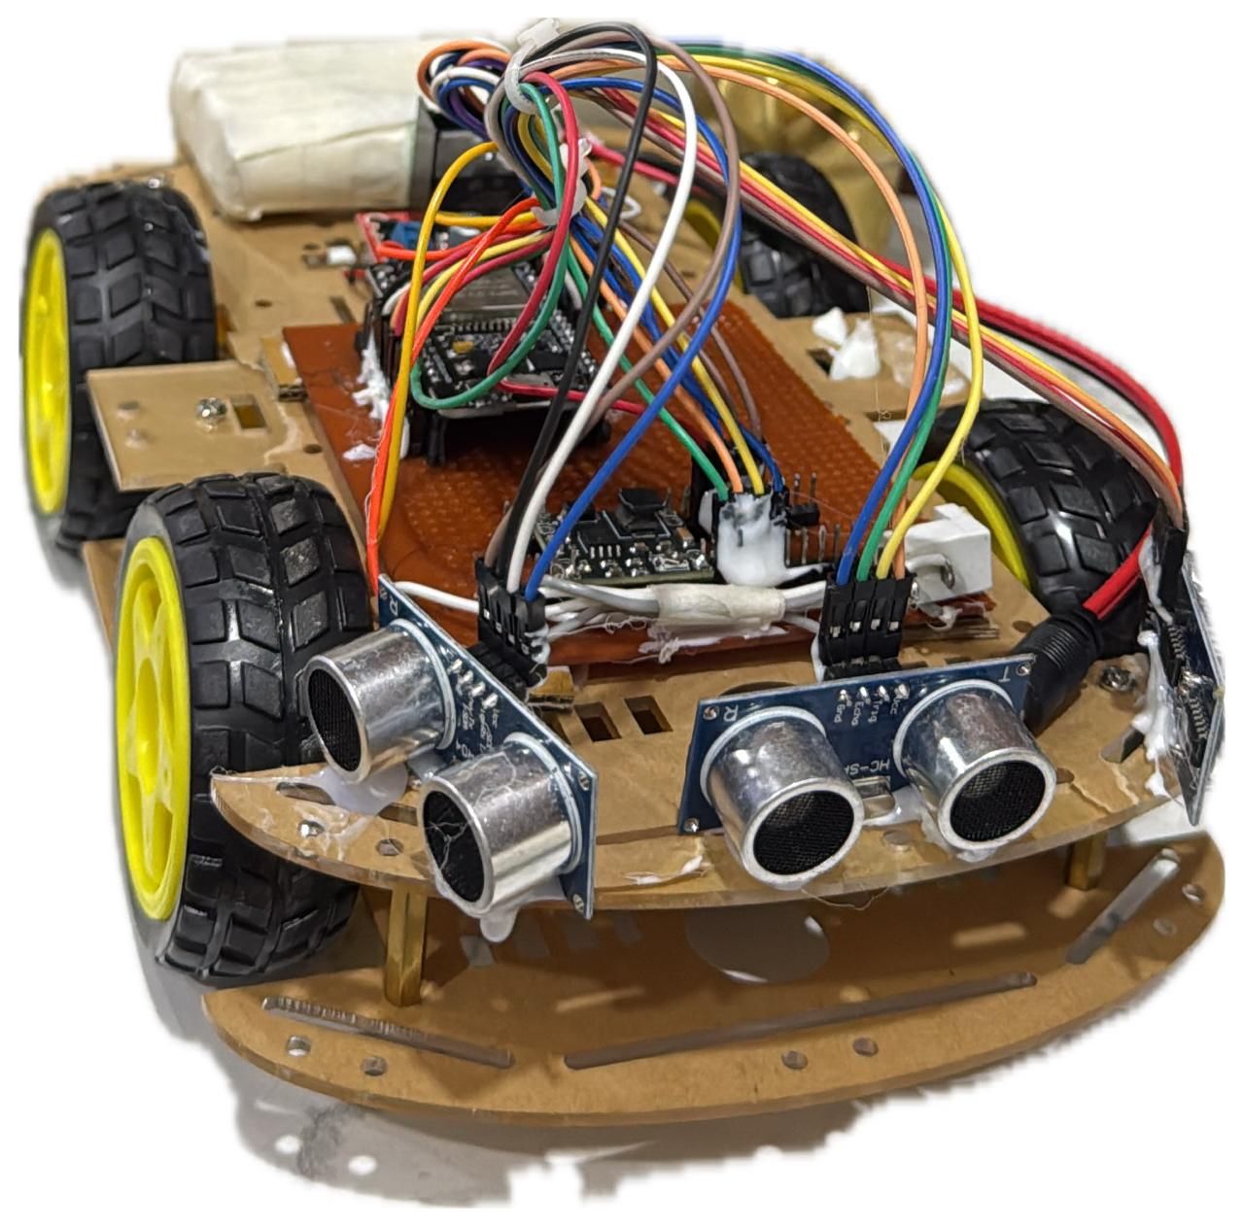
Output
Title of the Project

Slide 8
Advantages & Applications
ChatGPT said:
Advantage:
Improved Parking Efficiency: Automatically parks vehicles with precision, reducing human error and optimizing space usage.
Application:
Smart Parking Facilities: Used in automated parking garages to streamline vehicle entry, parking, and retrieval without human intervention.
Title of the Project

Slide 9
References
A. Al Mamun, A. R. Al-Ali, M. A. Al-Rousan, and S. A. Shattnawi, "Smart parking systems for autonomous vehicles using IoT and cloud computing," IEEE Internet of Things Journal, vol. 6, no. 3, pp. 4205–4213, Jun. 2019.
R. Rizvi and S. L. Maskari, "Design and implementation of an autonomous car parking system using Arduino," in Proc. IEEE Int. Conf. Smart Electronics and Communication (ICOSEC), Trichy, India, Sept. 2020, pp. 1374–1378.
Title of the Project

